Slide 1

Computational Cognitive Systems to Model Information Salience:
SpatioTemporal Template-based Search
Ellis L. Brown II¹, Adriane E. Seiffert², Noel Warford¹, Soobeen Park¹, Maithilee Kunda¹
¹ Dept. of EECS, Vanderbilt University
² Dept. of Psychology, Vanderbilt University
Notes:
This is work I performed with the
Lab for Artificial Intelligence and Visual Analogical Systems
-> Senior year @ Vanderbilt
Funded by US office of Naval Research
You might not be familiar with “information salience”
-> actually quite simple:
…how much a certain piece of information stands out
-> against other pieces of information

Slide 2
“Traditional” visual search
Visual Search
Very common human task
Static Visuospatial Target
Existence defined by features:
visual
fixed in time
Information Salience: how much a person notices a particular piece of visual information
Notes:
We see this idea in many everyday tasks..
Looking for keys in morning
Looking for reddest ripest basket of strawberries at the grocery store
….
These tasks can be classified as “traditional” visual search tasks
-> searching for target that is
------> visual
------> fixed in time
Targets:
Key within the bowl of junk
Reddest basket of strawberries
---
https://amblerfarmersmarket.files.wordpress.com/2014/05/straw.jpg
https://www.playwrightshorizons.org/media/filer/2015/05/06/qua_ebulletin_backstory.png

Slide 3
Visual Search
Different information processing requirements
Target-detection process has a temporal dimension
Spatiotemporal Target
Existence defined by features:
visual
variant over time
Notes:
Another variation of Visual Search involves searching for target that is
-> visual
-> variant over time
This type: different information processing requirements than the “traditional” variety
Great example:
Lifeguard watching children in crowded pool
-> target: child’s head under water for a long duration
…..
Targets cannot be detected from a single visual “frame” of perceptual experience, at a single point in time
much less widely studied than traditional visual search, both in psychology and in AI
----
http://usamanagement.com/wp-content/uploads/2015/10/Lifeguarding-wave-pool.png

Slide 4
“A Computational Cognitive Architecture to model Human Visual Search for Spatiotemporal Targets”
SpatioTemporal Template-based Search (STTS)
AAAI-18 Paper (submitted for blind review)
Soobeen Park¹, Ellis L. Brown II¹, Noel Warford¹ Adriane E. Seiffert², Kazuhiko Kawamura¹, Joseph S. Luddin, Maithilee Kunda¹
¹ Dept. of EECS, Vanderbilt University
² Dept. of Psychology, Vanderbilt University
³ Digital <>
Computational cognitive architecture
Support computational research into this alternative type of visual search
Notes:
Will give an overview of the STTS architecture, and insight into our preliminary findings
“Association for the Advancement of Artificial Intelligence”
Goal: lay groundwork for future research into spatiotemporal visual search
Specifically:
-> understand mechanisms human brain uses to solve this type of task

Slide 5
Chase Task
Notes:
AS A FIRST STEP:
we designed the STTS to solve a basic spatiotemporal search task
…that…
Members of our research team recently studied with human participants
We’re about to get interactive, and have you participate in the task
-> just like the participants in the study did!

Slide 6

Notes:
Video play on click
* One chaser and one prey dot on screen, frozen *
Red dot “prey”
Black dot “chaser”
When trial begins, the dots will move around randomly
At some unknown time, the black “chaser” dot will start “chasing” the red “prey” dot
I want you to raise your hand as soon as you notice this happen (the chase starting)
*play*
That was easy, right? Let’s ramp it up…

Slide 7

Notes:
Video play on click
* One chaser and one prey dot on screen, frozen *
Red dot “prey”
Black dot “chaser”
When trial begins, the dots will move around randomly
At some unknown time, the black “chaser” dot will start “chasing” the red “prey” dot
I want you to raise your hand as soon as you notice this happen (the chase starting)
*play*
That was easy, right? Let’s ramp it up…

Slide 8

Notes:
Video play on click
Ok, so we’re gonna do the same thing
Except this time, there are 5 chaser dots
-> only one black dot will chase the prey, just as last time
Again, I’d like everyone to raise their hands the moment they notice the chase event happening
*play*
Little bit harder right?
Ok lets ramp it up one more time…

Slide 9
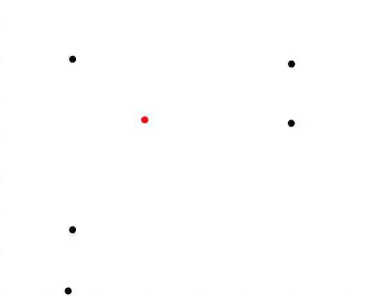
Notes:
Video play on click
Ok, so we’re gonna do the same thing
Except this time, there are 5 chaser dots
-> only one black dot will chase the prey, just as last time
Again, I’d like everyone to raise their hands the moment they notice the chase event happening
*play*
Little bit harder right?
Ok lets ramp it up one more time…

Slide 10
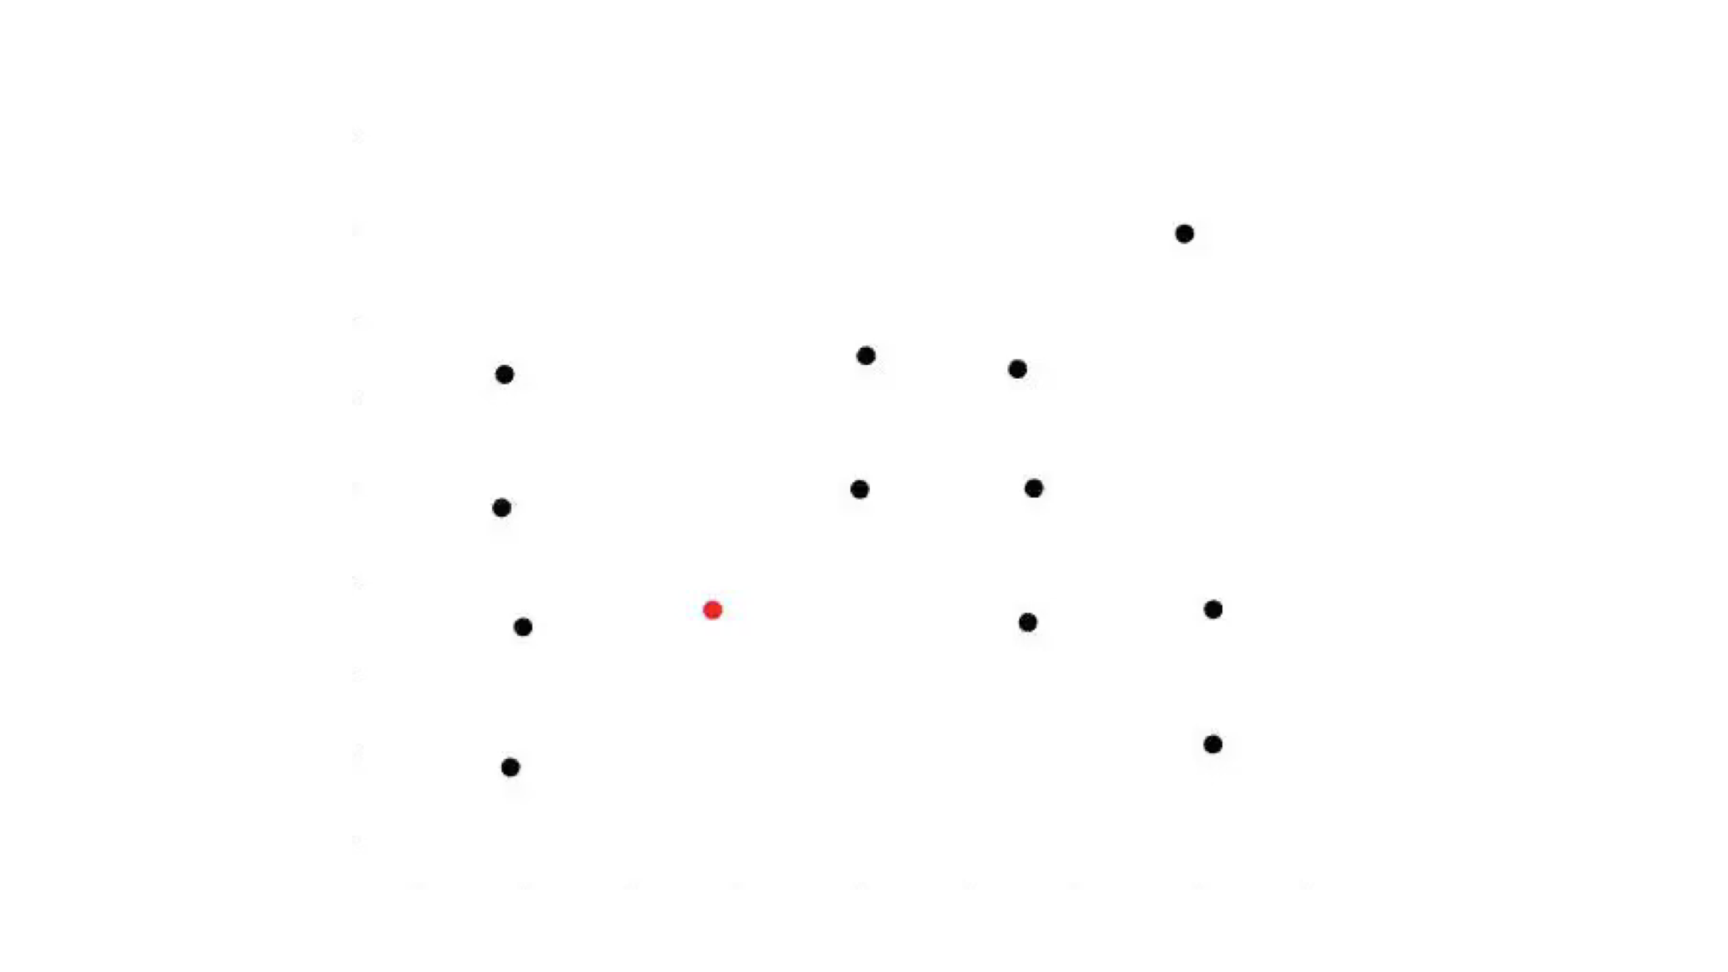
Notes:
Video play on click
Ok, so yeah… this one’s gonna be a little bit harder
Let’s have everyone try and raise their hand when the chase happens, one last time
*play*
Hahah okay great work everyone, thanks for participating in our study…

Slide 11
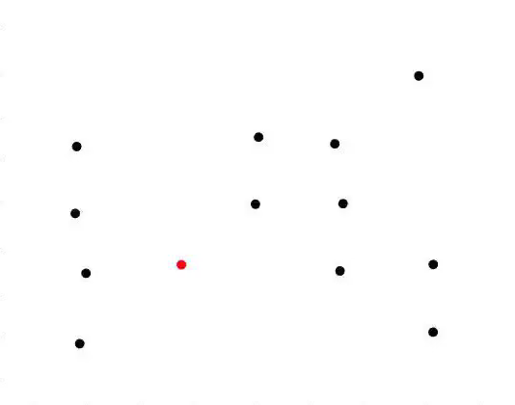
Notes:
Video play on click
Ok, so yeah… this one’s gonna be a little bit harder
Let’s have everyone try and raise their hand when the chase happens, one last time
*play*
Hahah okay great work everyone, thanks for participating in our study…

Slide 12
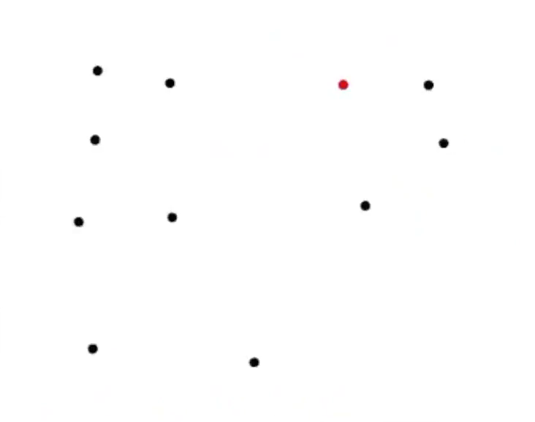
Chase Task
Basic spatiotemporal search task
participant cannot respond based on instantaneous glance
Target: a spatiotemporal “chase event”
Notes:
Studying the results from various chase task setups…
…our research team (on psychology side) found:
interesting evidence of attentional capacity limitations
-> seem to be related to the spatiotemporal nature of the task
Gets harder to pay attention to all the chasers when there are more flying around
-> makes it harder to discern the “chase event”
the target requires participant to monitor the display for some duration in order to make a successful detection
……..
I’ll now give a brief overview of the our architecture for artificially solving this task…
But first id like to share an observation made by our research team during human participant studies
-> that is the core inspiration for our approach
-> chase event often “looks” like straight line motion of a chaser towards the target
----> especially when chaser still far from the prey
-----------------
// Responses:
// false negative (missed detection) -- don’t detect the chase by time chaser caught prey
// false positive -- respond but no chase has yet occurred
// true positive – respond during chase before prey caught
// true negative – NONE, every trial has a chase event

Slide 13
STTS Agent Architecture

Slide 14
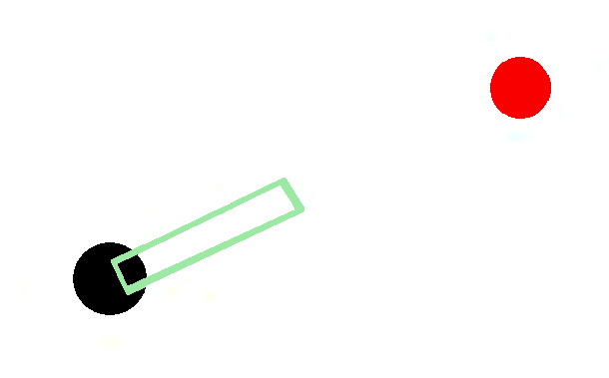
Templates explained
Multidimensional spatiotemporal projection
2D mental “movie” predicting motion of a chaser over time
Extends straight towards prey
Basis of the STTS Agent architecture
t=0
t=1
t=2
t=28
t=29
t=30
Prey (t=0)
time
Notes:
This observation led us to create the idea of a “template”
-> multidimensional spatiotemporal projection
---> represents the predicted position of a single chaser over some time
Straight line towards prey at t=0
-> when the agent begins looking at the chaser
STTS Agents monitor the real positions of the chaser over the course of the template
-> compare real position @ time to predicted position @ time
-----> here “agent” refers to any one specific assignment of parameters representing a concrete, runnable search strategy

Slide 15
Essential STTS Agent Parameters
# Templates
How many templates the agent can simultaneously attend to
Length of template
# timesteps
Distribution method
How the agent selects next chaser to consider
Evaluation method
How the agent decides if target detected
Notes:
There are a number of different parameters that customize the basic behavior of this agent type
all designed based on psychological theory:
For the sake of time, I can go over some of these in more detail at the end
----
# Templates
- in each template
Length of templates (k)
- # timesteps long each template is
Distribution method
Serial: selects chasers in a predetermined, fixed, arbitrary order.
Uniform: selects from available chasers randomly with uniform probability.
(Linear: selects from available chasers randomly with probabilities linearly proportional to distance between prey and each chaser)
(Quadratic: selects from available chasers randomly with probabilities quadratically proportional to distance between prey and each chaser)
Evaluation Method
Cumulative Distance Threshold
sum distance from real pos to predicted pos @ each timestep in template
compare to set threshold at end of template (over threshold -> fail, under -> pass)
(Radius Threshold)
checks if real pos withing certain radius of predicted pos @ each timestep
if always within radius by end of template, pass
(Inhibition of return)
-> how long the agent will wait to reconsider the same chaser, once finished evaluating given chaser
----> i.e. “reselect” via distribution method
-> for the randomized selection methods (Uniform, Linear, Quadratic
(Early kill)
-> allow early termination? or require templates to be deployed for k timesteps
NOTE: there are other potential categories of agents
-> we built out and experimented with the Past-Comparing Agent
Past-Comparing Agent:
-> every chaser is given a template that points away from the prey at that time
-> agent queries certain templates at different times

Slide 16
Experiments
Notes:
In the experiments:
Created agents to solve task
Vary # chasers 1-12
Run 1000 trials per setup, take average
See effect of varying individual parameters on same agents
Compare various agents to each other
THIS AREA:
Has a lot of work to be done

Slide 17
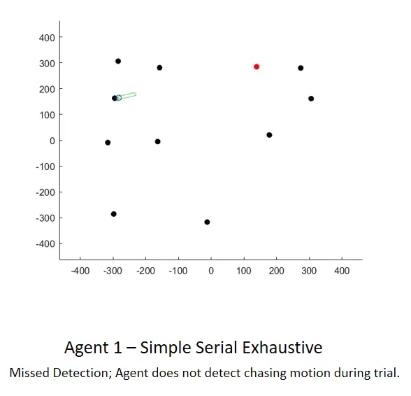
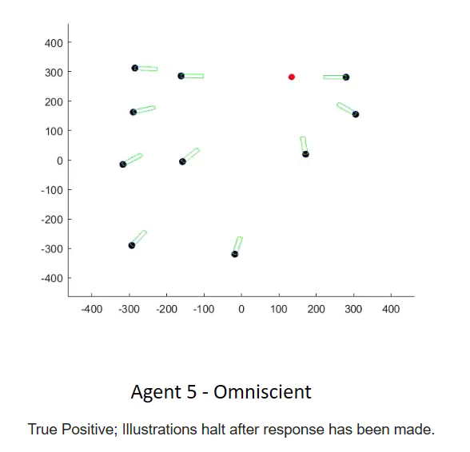
Notes:
Video of two different agents solving the same task
We created various agents
-> based upon prevailing psychological theories
Here’s a rendering of two different completed agents solving the same task
Ran batches of experiments
-> on various # chasers
---> averaged results from 1000s of independent trials (w/ same setup)

Slide 18
note: each datum is the average result from 1000 trials
Notes:
Because a research presentation wouldn’t be a research a presentation without a graph…
Heres
ACC & reaction time for these two agents

Slide 19
Applications
Lay groundwork for more research
Understand attentional bottlenecks
Notes:
NOTE:
While chase task relatively simple
especially compared to spatiotemporal searches that humans regularly perform in complex, naturalistic environments
we expect studying this task will lay the foundations for continued research into more realistic search tasks in the future
-> is first step to UNDERSTAND the computational nature of attentional bottlenecks in this type of task
Applications:
Military operators monitoring extremely complex displays
Heads up displays
--------
This architecture differs b/c it explicitly enables the study of the temporal dimension in a spatiotemporal search task
-> i.e. the act of target detection is itself a temporal process that must integrate information over time
Continued research with the STTS architecture will include
-> more detailed definitions of agents (based on prevailing psychological theories)
-> comparisons with human performance data on the same task.
We expect that in the long run, results from this research will help refine the design of visual information displays to help human operators perform more efficiently and effec- tively on difficult, real-world monitoring tasks.

Slide 20

Slides will be available at:
http://ellisbrown.me
Notes:
I’ll post the slides from my talk on my personal site early next week!
ellis brown (dot) me
---------
There is a model called Itti salience model that is pretty well known; that is a computational model that models visual salience as a function of visual properties (static visual properties); very interesting work, but different from our model in its goals. That model essentially tries to model "free viewing" of realistic scene images; where do people tend to look if you just show them a random picture? So that one is a model of salience, but not of visual search. There have been some visual search models, you can see the "related work" section in the AAAI paper, there is a paragraph on AI approaches that has some relevant references.

Slide 21
Image Sources
https://www.playwrightshorizons.org/media/filer/2015/05/06/qua_ebulletin_backstory.png
https://amblerfarmersmarket.files.wordpress.com/2014/05/straw.jpg
http://usamanagement.com/wp-content/uploads/2015/10/Lifeguarding-wave-pool.png
http://aemstatic-ww1.azureedge.net/content/dam/avi/online-articles/2015/March/Rockwell%20Collins%20HGS.jpg
https://i.ytimg.com/vi/P0GI-1gja5Q/hqdefault.jpg

